Slide 1

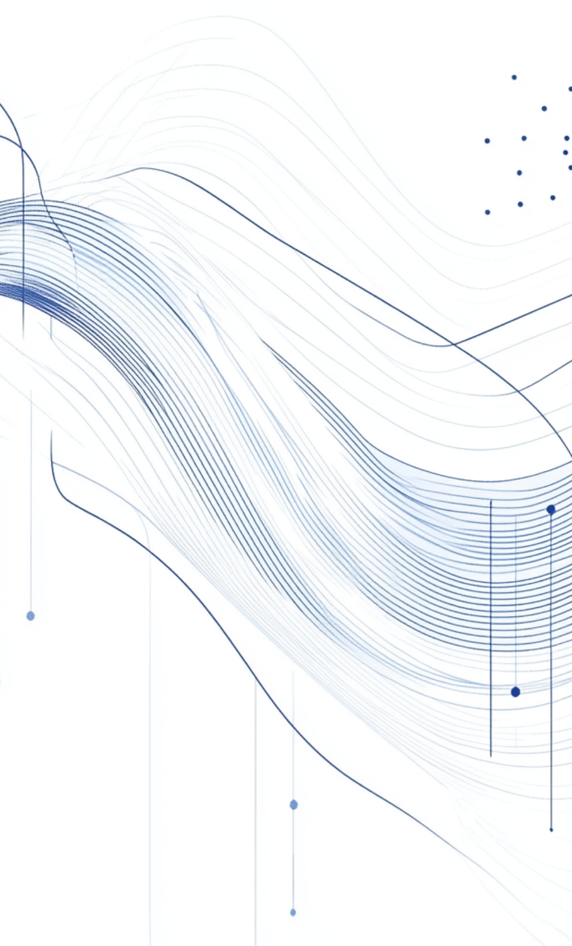
Moodify
This project focuses on detecting emotions through facial expressions and providing personalized story and song recommendations based on those emotions.

Slide 2

Identifying and Addressing Emotional Needs
Identifying Emotional Needs
Importance of Emotion Recognition
Wide Range of Applications
The system can benefit areas like therapy, creative storytelling, and enhancing user experiences in apps.
Many people struggle to articulate their feelings, leading to a lack of appropriate emotional responses or support.
Understanding emotions can play a crucial role in mental health, entertainment, and personalized experiences.

Slide 3


Project Objectives
1
Real-time Emotion Detection
2
Personalized Recommendations
3
Enhancing User Interaction
Detect emotions from facial expressions in real-time using advanced techniques.
Suggestions for uplifting stories and songs based on detected emotions.
User-friendly interface with easy input and immediate feedback.

Slide 4



Dataset Used
Description
2
The dataset contains over 35,000 labeled images across seven emotion categories, with a resolution of 48x48 pixels.
Dataset Name
1
FER2013, chosen for its robustness in emotion detection tasks.
Preprocessing Steps
3
Images are resized, normalized, and augmented to improve model accuracy and prevent overfitting.

Slide 5


Model Architecture Overview
Using CNN with MobileNetV2
Layer Diagram
Training Details
A visual representation of layer composition, including convolutional, pooling, and fully connected layers.
Model trained over 50 epochs with an accuracy of 80%, using AdamW optimizer to achieve optimal performance.
This lightweight architecture is selected for its efficiency and accuracy in image processing tasks.

Slide 6



Frontend Design Features
Image Upload & Webcam Input
2
Users can either upload images or use live webcam input for emotion detection.
Built with React JS
1
Leveraging React for a responsive, dynamic user interface.
Real-time Emotion Display
3
Immediate feedback on detected emotions enhances user engagement and interaction.

Slide 7

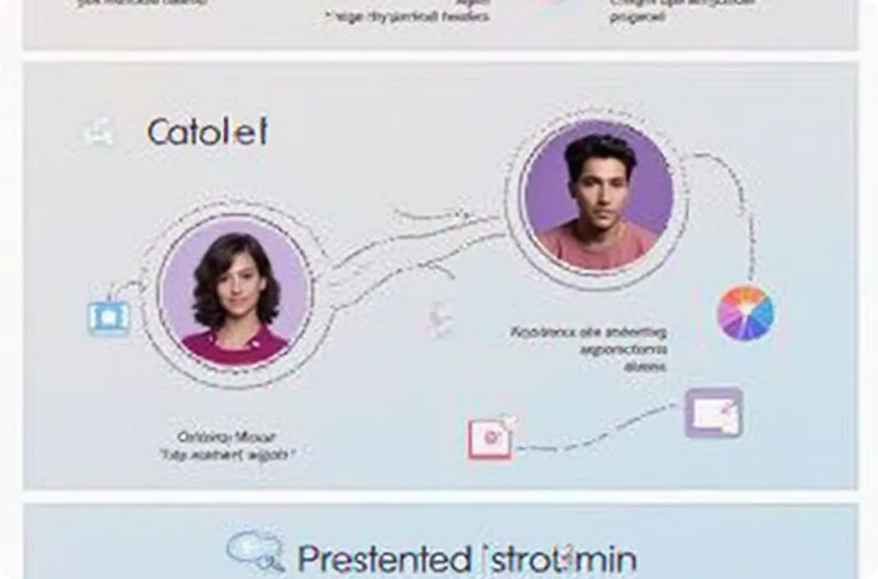

Backend & Model Integration
FastAPI for Serving Model
Prediction Handling
Recommendation Logic
FastAPI is employed for its speed, enabling quick handling of image inputs and predictions.
The backend processes the uploaded images and returns the detected emotions seamlessly.
Based on the predicted emotion, the backend fetches appropriate stories and songs from a predefined database.

Slide 8



System Flow / Architecture Diagram
1
2
3
Interaction Overview
Emotion Processing
User Journey
Integration of React frontend, FastAPI backend, and CNN model.
Flow starts with emotion detection leading to recommendations.
Transformation of user inputs into actionable insights.

Slide 9



Recommendations Logic
Happy
Sad
Angry
Recommend a cheerful song like 'Happy' by Pharrell Williams and an uplifting story.
Suggest a comforting song like 'Someone Like You' and a reflective story.
Propose an energetic song like 'Stronger' by Kanye West and an empowering story.

Slide 10



Demo Screenshots and Output Overview
Recommendations
Showcasing story and song suggestions on the same interface.
Visual Engagement
GUI Screenshot
Embed demo images or short GIFs to illustrate the functionality in action.
Display of the user interface featuring emotion detection results.
2
1
3

Slide 11




Results & Performance Overview
80
100%
90
Model Accuracy
Confusion Matrix
Real-time Responsiveness
Achieved a predictive accuracy during testing phases.
Visual representation of model precision across emotional categories.
Emphasizes practical usability with immediate feedback.

Slide 12

Challenges Faced in Model Development
Dataset Quality Issues
Model Overfitting
Integration Hurdles
Overcoming noise and inaccuracies in the FER2013 dataset required careful preprocessing.
Ensured regularization techniques were applied to balance learning on training and validation data.
Streamlining communication between FastAPI backend and React frontend presented initial challenges.

Slide 13

Future Scope
1
Voice-Based Input
2
Real-Time Emotion Tracking
Explore adding functionality for capturing emotions through vocal tone analysis.
Implement continuous emotion monitoring using webcam feed for enhanced interaction.
3
Third-Party Integration
4
Emotion Category Expansion
Consider integrating platforms like Spotify or YouTube for seamless access to music recommendations.
Work on enlarging the emotion categories for a richer user experience.

Slide 14
Conclusion of Emotion Detection and Recommendation System
Prototype Achievements
2
Functional prototype with high accuracy.
Emotional Engagement
1
Enables users to access tailored content.
3
Responsiveness
System designed for quick user feedback.

Slide 15


Thank You for Connecting
For inquiries, feel free to connect via LinkedIn or GitHub. Let's continue the conversation!
Inquiries
Connect on LinkedIn
Connect on GitHub
"For any inquiries about Moodify, our emotion detection system, feel free to reach out to us. We're here to support you with all your emotion analysis and AI-powered insights."
https://www.linkedin.com/in/tanishq-kakkar-773207214/
You can also connect with me on GitHub.
https://www.linkedin.com/in/yashmit-rathee-796b29282/
https://github.com/TanishqKakkar/moodify

Slide 16



Team Collaboration
Tanishq
Yashmit Rathee
Led FER2013 data preprocessing by converting pixel data into RGB images.Trained and fine-tuned a MobileNetV2-based CNN for accurate emotion classification
Developed React.js frontend and integrated the FastAPI backend for real-time emotion detection and recommendations.

